Slide 1
Flight Price Prediction Project
Vikash Kumar singh

Slide 2
Problem Statement And Understanding
Anyone who has booked a flight ticket knows how unexpectedly the prices vary. The cheapest available ticket on a given flight gets more and less expensive over time. This usually happens as an attempt to maximize revenue based on –
1. Time of purchase patterns (making sure last-minute purchases are expensive) 2. Keeping the flight as full as they want it (raising prices on a flight which is filling up in order to reduce sales and hold back inventory for those expensive last-minute expensive purchases)
So, you have to work on a project where you collect data of flight fares with other features and work to make a model to predict fares of flights.

Slide 3
In general, any machine learning problem can be assigned to one of two broad classifications: Supervised learning and Unsupervised learning.
Supervised Learning: - In supervised learning ,we are given a data set and already know what our correct output should look like, having the idea that there is a relationship between the input and the output. Supervised learning problems are categorized into “regression” and “classification” problems.
In a regression problem, we are trying to predict results within a continuous output, meaning that we are trying to map input variables to some continuous function.
In a classification problem, we are instead trying to predict results in a discrete output. In other words, we are trying to map input variables into discrete categories.
Unsupervised Learning: -Unsupervised learning allows us to approach problems with little or no idea what our results should look like .We can derive structure from data where we don’t necessarily know the effect of the variables. We can derive this structure by clustering the data based on relationships among the variables in the data. With unsupervised learning there is no feedback based on the prediction results.

Slide 4
EDA steps and visualizations :
Cleansing the dataset:
This is an essential step to perform before creating a visualization. Clean, consistent data will be much easier to visualize.
Data cleaning tasks will be very dependent on the dataset that you’re working with. In most cases, data cleaning involves:
Removing unnecessary variables
Checking for Null Values
checking for duplicates
Dealing with missing values
Standardizing or categorizing values
Correcting typographical errors

Slide 5
Data Visualization:
The data preparation steps involve various type of visualization, which include:
bar plot.
Scatter plot .
Distplot.
Box plot.
Heat map.
Pair plot.

Slide 6
Steps and assumptions used to complete the project:
Importing data set
Checking All Column Name
Checking Total Numbers of Rows and Column
Information about Data (Memory Used and Data Types)
Checking for Null Values
dropping the unnecessary columns
Checking total number of unique value in each column of Dataset
Data Cleaning
EXPLORATORY DATA ANALYSIS (EDA)
Strip plot
Pair plot
Bar plot
Count plot
Dist plot
Box plot
Heat map
Encoding
removing the outliers
Removing the skewness
Vif
separating the target from other features
splitting the train and test dataset
scaling the dataset
Metrics-explained variance, mean absolute error, mean squared error ,r2 score, adjusted r2 score
Accuracy; cross validation score with cv=5
Models
Hyperparameter tuning

Slide 7
Models:
Names:
Linear regression
Random forest regressor
Decision tree regressor
Support vector regressor(SVR)
Kneighbour regressor
XGB regressor
Lasso regressor
Ridge regressor
Adaboost regressor
Gradient boosting regressor
Accuracy:
45.20%
48.93%
22.91%
39.31%
26.51%
44.14%
-0.3%
28.56%
37.63%
52.62%

Slide 8
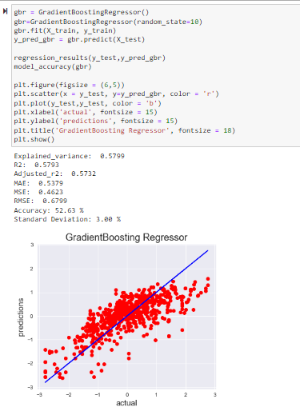
Finalized model:
Model 10; Gradient Boosting Regressor is our best model among all.

Slide 9

Conclusion:

Slide 10
THANK YOU

